Slide 1

Gender Bias in Machine Translation (2021)
Authors: Beatrice Savoldi, Marco Gaido, Luisa Bentivogli, Matteo Negri, Marco Turchi

Slide 2
Pattern Recognition Paper Review
Nazmul Hasan Wanjan
ID: 18201133
Group Number: 1
Brac University, Spring 2023

Slide 3
Issues Focused
Critical Review of current conceptualizations of bias
Summarization of previous analyses aimed at assessing gender bias in Machine Translation (MT)
Discussion on bias mitigating strategies so far

Slide 4
Current Conceptualizations of Bias
What is bias?
Possible outcome of mental shortcuts that can be critical to support prompt reactions

Slide 5
Current Conceptualizations of Bias
Instances of bias in NLP
Co reference systems failing to recognize women doctors
Image captioning models failing to detect women sitting next to a computer
Automatic speech detection systems working better with male voices
Commercial MT systems failing to recognize women in STEM (Science, Technology, Engineering and Mathematics) occupations despite having many feminine mentions

Slide 6
Current Conceptualizations of Bias
Problems with current approaches
Monolingual Applications
Not taking multi-facetedness of MT into account
Dichotomy approach in datasets

Slide 7
Current Conceptualizations of Bias
Harms of Gender Bias in MT Systems
Representational Harms
- Under-representation
- Stereotyping
Allocational harms
propagation of generalizations of a social group that causes differences in the service quality provided by the MT systems

Slide 8
Current Conceptualizations of Bias
Language groups based on extra-linguistic reality of gender
Genderless languages
- only expresses gender-specific repertoire for basic lexical pairs (boy-girl, father-mother)
Notional gender languages
- languages that display a system of pronominal gender on top of lexical gender (usage of separate pronouns, etc.)
Grammatical gender languages
- languages in which several parts of speech beside nouns carry gender inflections (la cocina, el pastel)

Slide 9
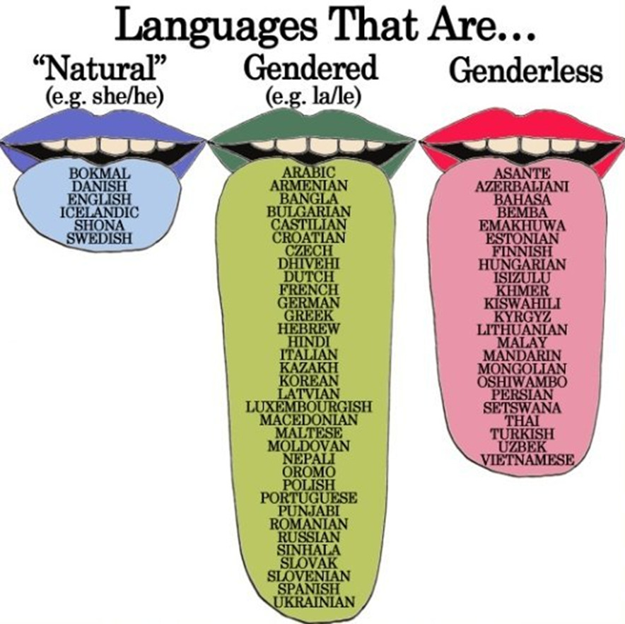
Current Conceptualizations of Bias
Language groups based on extra-linguistic reality of gender

Slide 10
Assessing Bias
Methods
1. Manual analysis
-Looking at the source and target languages contrastively
2. Quantitative works
-Masculine default behavior
3. Designing dedicated benchmarks, evaluations and experiments

Slide 11
Assessing Bias
Existing benchmarks
1. Occupations test set
- Context added to occupation
- System exhibits gender bias if it disregards relevant context and cannot provide the correct translation at the same rate across genders
2. WinoMT
- To check the ability of the system to resolve anaphoric relation
- How often the system picks the correct gender inflection for the occupational nouns
MuST-SHE
- complements BLEU and accuracy based evaluations on gender translation

Slide 12
Assessing Bias
Existing benchmarks
Expanded WinoMT
Open subtitles
Europarl

Slide 13
Mitigating Bias
Model Debiasing
1. Gender Tagging
- prepending a gender tag (like M or F) to each source sentence, both at training and inference time
2. Context adding
- by concatenating each sentence with the preceding one
Debiased Word embeddings
Hard debiasing: Removing gender associations
GN-Glove algorithm: isolating the gender associations from the representations of English gender-neutral word
Balanced Fine-tuning
- building gender balanced datasets

Slide 14
Mitigating Bias
Debiasing through external components
Black-box Injection
Lattice Re-scoring
Gender Re-inflection

Slide 15
Future Directions
Non-textual modalities
Beyond dichotomies
Human-on-the-loop

Slide 16
Thank You!

